Slide 1
Web Mining - Wikilosophy
Raed Abdennadher, Ludovic Gindre & Edward Ransome

Slide 2
Initial observation
“Wikipedia trivia: if you take any article, click on the first link in the article text not in parentheses or italics, and then repeat, you will eventually end up at “Philosophy””

Slide 3
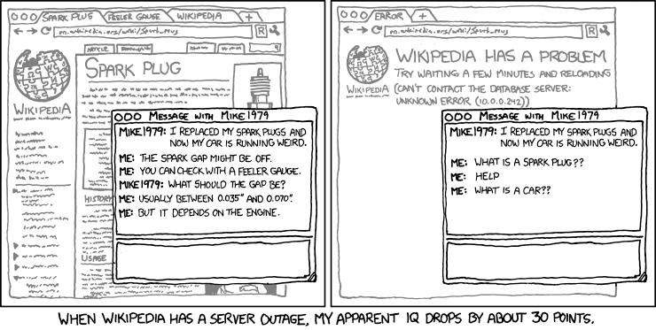
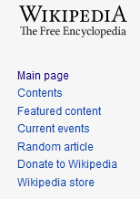
Context
Previous quote first appeared on the alt-text of the xkcd webcomic #903
As of February 2016, 97% of all articles lead to Philosophy in this manner
Try it!
https://xkcd.com/903/

Slide 4
Why does this happen?
Most pages start by describing the topic of the page
Topics naturally get broader as they contain multiple other topics
Eventually we reach the widest reaching pages, such as Mathematics, Science, and Philosophy

Slide 5
Objectives
Crawl the entirety of the English Wikipedia in this manner (code should be easily adaptable to other languages)
Calculate an up-to-date estimate of how many pages lead to Philosophy
Calculate connected components sizes
Estimate average distance from a random page to Philosophy
Graph visualisation if feasible

Slide 6
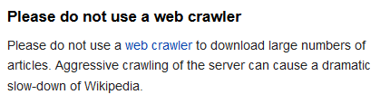
Data
Wikipedia regularly blocks IP addresses performing excessive crawling (not viable for an entire site crawl)
A downloadable database of all Wikipedia pages is available as XML
Contains an index with byte offsets allowing to decompress 100 page sections at a time
Approximately 16GB in size and 200MB for the index
Kind disclaimer on the Wikipedia Offline Dump page
https://en.wikipedia.org/wiki/Wikipedia:Database_download

Slide 7
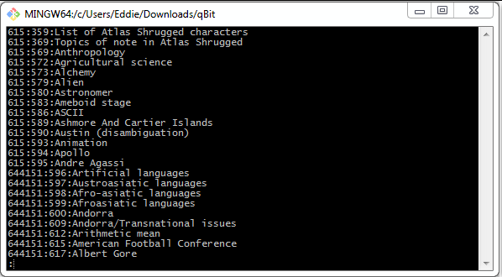
Index structure
Byte offset
Page ID
Page Title

Slide 8
Graph generation
Each page represents a graph vertex
Easy to create an edge list using the index
Unzip 100 pages
For each page, find the first hyperlink not in italic or parentheses
Place the start and end vertices separated by a tab character in a file
Size of edge list should around the same size as the index since they both contain one line per page
Must only be done once (unless using a different dump or language)

Slide 9



Technologies
Java
Apache Commons Compress API for decompression
(Allows the use of an offset)
Neo4j (Allows graph analysis and importation using an edge list)

Slide 10
Expected result
A large connected component that includes most of the pages that do not lead to Philosophy
We expect another large science-related page
A large number of authorities linking to the Philosophy page (the graph should have a tree structure leading to Philosophy)
A certain number of dead-ends, pages with no valid hyperlink leading to a new page

Slide 11
Risks and problems
Large graph size might make visualisations unfeasible
Since the 2016 estimate, there are a lot more pages that do not lead to Philosophy (Based on random tests we performed)
Group has no experience with Neo4j or Apache Commons Compress API

Slide 12
Planification
Decompress XML pages using a Java library (By 10.05)
Parse the XML to find the first valid hyperlink (By 10.05)
Create graph and import to Neo4j (By 17.05)
Analyse graph using Neo4j and aggregate interesting statistics (By 24.05)
Finish project, complete report, add any additional features like visualisations (By 07.06)
Finishing touches for project end date (10.06)

